Slide 2
Objectives
Describe the role and basic functions of an operating system including:
Understand how hardware, firmware and an operating system are required to run applications software
Managing files
Providing an interface
Managing peripherals and drivers
Managing memory
Managing multitasking
Providing a platform for running applications
Providing system security
Managing user accounts

Slide 3

Starter
In pairs, write down as many operating systems as possible
Also write down the devices that the operating systems are used on

Slide 4
Starter
Operating system | Used on the following devices
MacOS | Apple Mac computers
Windows 10, Windows 11 | PCs
iOS | Apple iPhone
iPadOS | Apple iPad
Android (based on Linux) | Various smartphones and tablets
Linux | Servers; some home or work computers, especially for those with technical computer jobs
Raspberry Pi OS (based on Linux) | The operating system for Raspberry Pi
Chrome OS | Chromebook
What is an operating system and what is it responsible for doing?

Slide 5
Operating system
An operating system is responsible for managing the hardware and software in a computer including:
Managing files
Providing an interface
Managing peripherals and drivers
Managing memory
Managing multitasking
Providing a platform for running applications
Providing system security
Managing user accounts

Slide 6
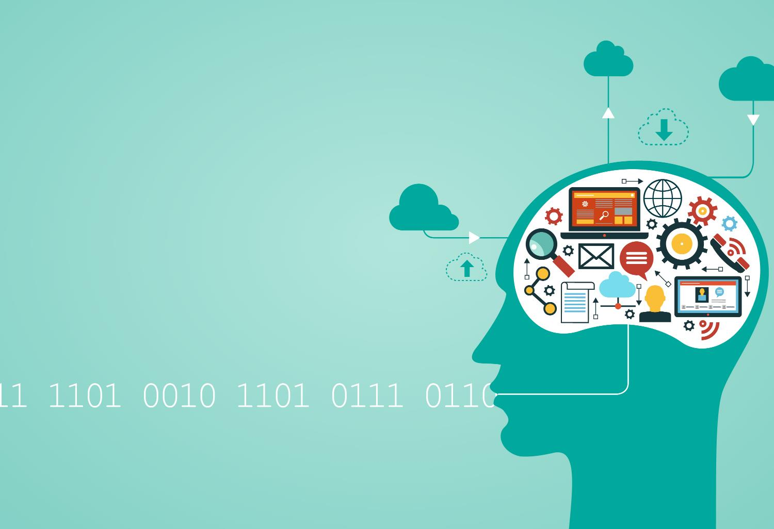

User interface
Without a user interface we would have no way of communicating with a computer
The user interface allows the user to tell the computer what to do
The user interface also shows the results after processing
Name three different types of user interface

Slide 7
Types of user interface
GUI: Graphical User Interface
WIMP: Windows, Icons, Menus and Pointers
Menu-driven interface
CLI: Command Line Interface
Text is used. Commands are typed and all output is in text This type of interface is used in Windows command prompt
Voice activated
This is used by assistants such as Siri and Amazon Alexa
Real-time
sensors detect inputs, actuators output actions

Slide 8
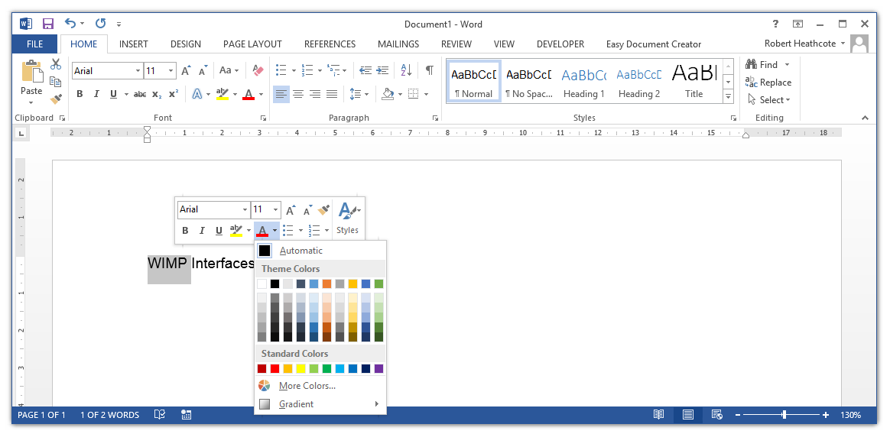
WIMP interfaces
Windows makes use of a WIMP user interface
This is because it uses: Windows, Icons, Menus and Pointers

Slide 9




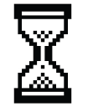


WIMP interfaces
Windows are used to show each different program that is currently open
The user can click on icons using a pointer or cursor
Icons represent key functions rather than having to type instructions
Icons are also used to launch programs
Menus are used within programs and also as context-sensitive menus when you right-click
Different shaped pointers indicate the current function of the pointer or state of the computer

Slide 10
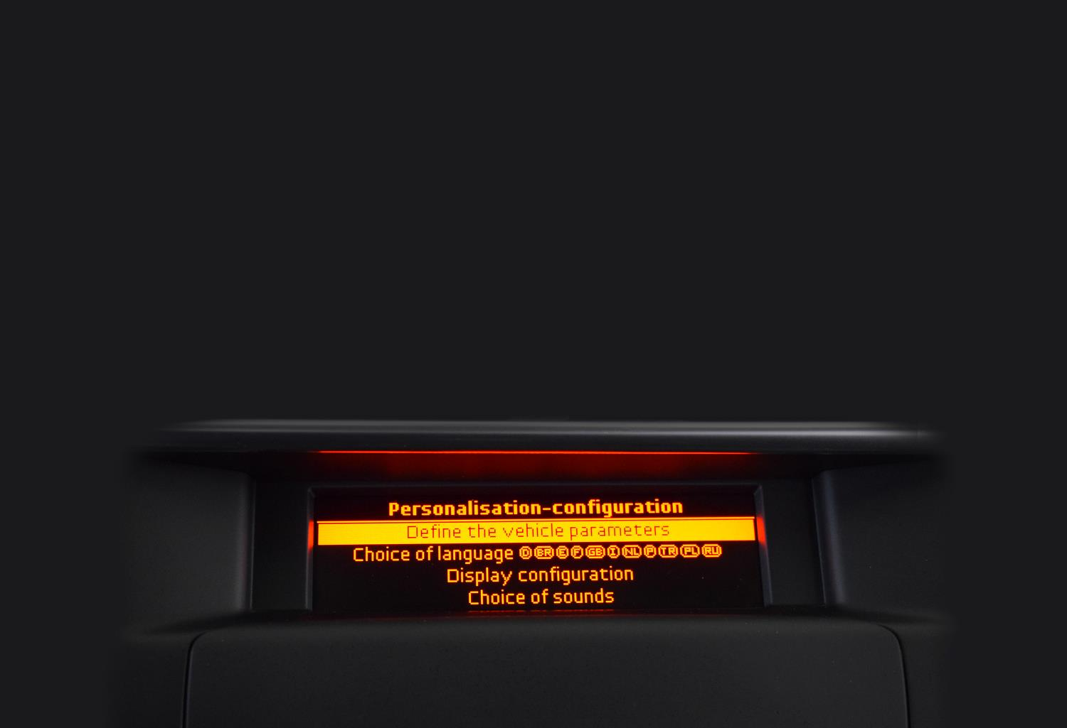

Menu-driven interfaces
Menu-driven interfaces make use of menus where the user selects options that lead to further sub-menus
Some music players still make use of menus
Menus are often used for settings on televisions

Slide 11
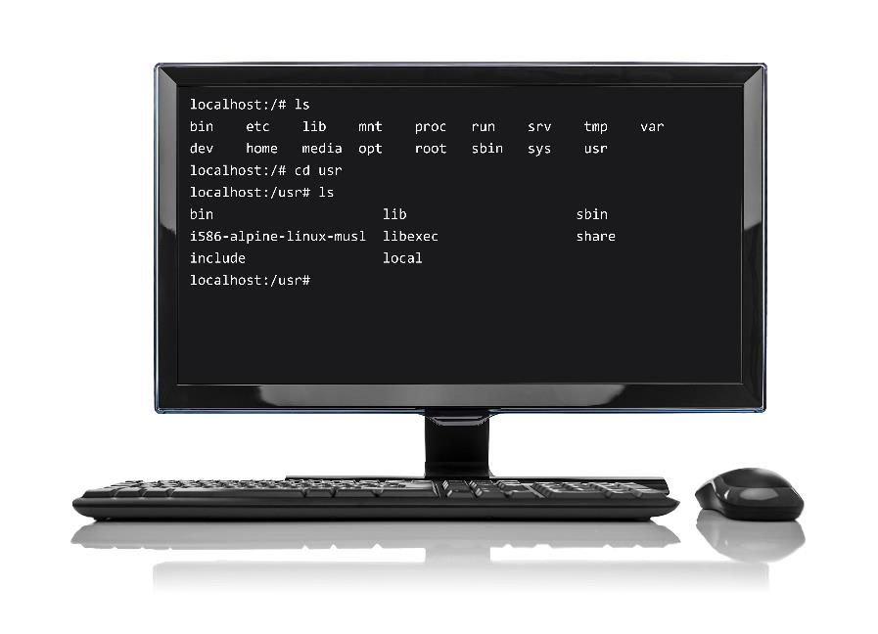
Command line interface
Command line interfaces are also known as text-based user interfaces
They allow the user to enter commands by typing
Only text is displayed
Command line interfaces are faster to use for some tasks if the user knows how to use them
They also take less disk space and RAM

Slide 12
Worksheet 2
Complete Task 1 on Worksheet 2

Slide 13
Platform for running programs
When you open a program the operating system loads the program into RAM
The operating system provides a platform for each program that is running on the computer
The operating system deals with where the program and data goes in memory (memory management), the saving of files and how much time each program has to use the CPU (task management)
This is why software is released for a particular operating system as well as a particular computer architecture

Slide 14
Memory management
To run a program, the computer must copy each program from storage into main memory
Data used by the program is also copied into main memory
The operating system keeps a record of where each program and its data are located
The operating system also makes sure that programs do not overwrite existing programs
Main memory (RAM)
File A
Program D
Program A
File C
Program A
Program B
OS
Array
Program E

Slide 15
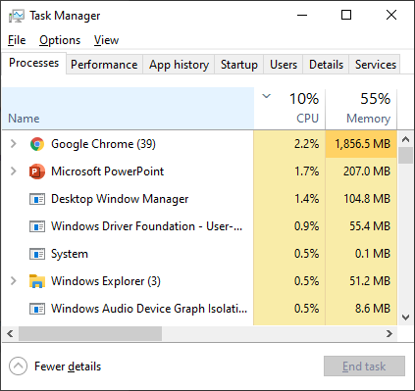
Multi-tasking
People use their computers to run several programs at the same time
Each program is given a short time on the CPU before it is paused by the operating system
The operating system then allows the next program to make use of the CPU for a short time
By switching quickly between different programs (tasks), it appears to the user that all of them are happening at the same time

Slide 16
Worksheet 2
Complete Task 2 on Worksheet 2

Slide 17
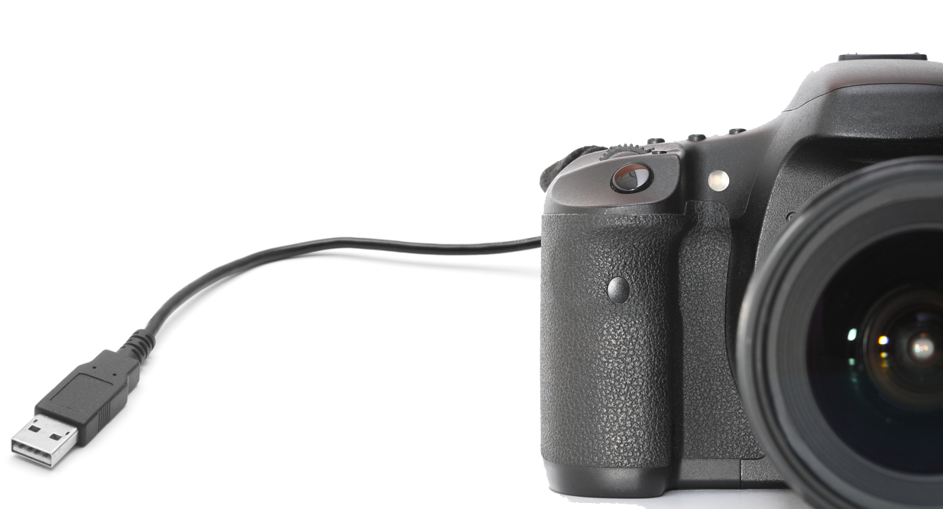

Managing peripherals
Peripheral devices include keyboards, mice and printers
Name at least four other peripheral devices

Slide 18
Peripheral devices
Some other peripheral devices include:
Digital cameras and webcams
Graphics tablets
Microphones
Solid state media (USB sticks and SD cards)
Magnetic tape drives
Bar code reader
RFID reader
Optical drives (CD, Blu-ray and DVD drives)

Slide 19
Device drivers
Each peripheral device requires a device driver to operate
The device driver allows the operating system (and therefore programs) to access the device
The device driver must be installed before the device may be used
Device drivers will be written in assembly language or a language that can access low level instructions – this is because they have to precisely control the hardware devices

Slide 20
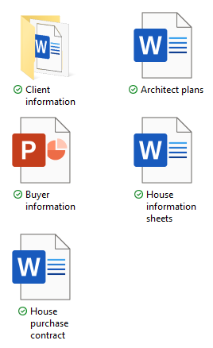
Managing files
Operating systems contain a file system
This allows both users and programs the ability to copy, save and rename files
Files may also be placed in folder which are also known as directories in text-based systems
Saving files is often a complicated process, but for the programmer it is easy as they just ask the operating system to do it
Why is it hard for an operating system to save a file?

Slide 21
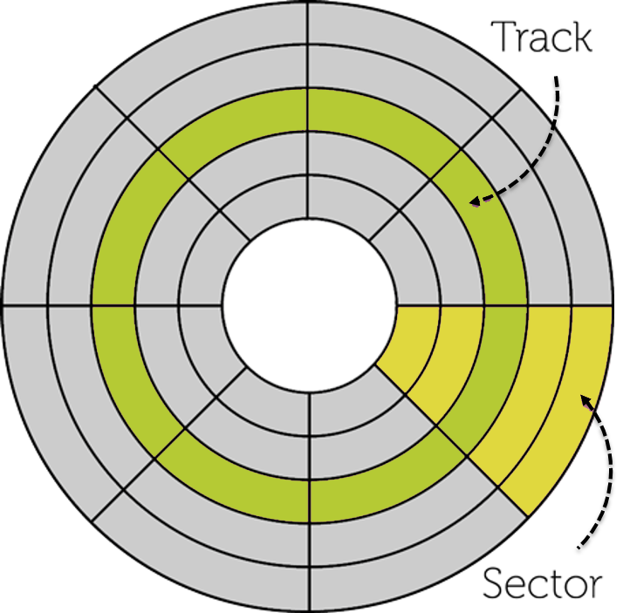
Disk and file management
The operating system must manage the following
Which platter to save to
Which track to send the drive head to
Which sector needs to be accessed
Make sure that files don’t write over existing ones

Slide 22
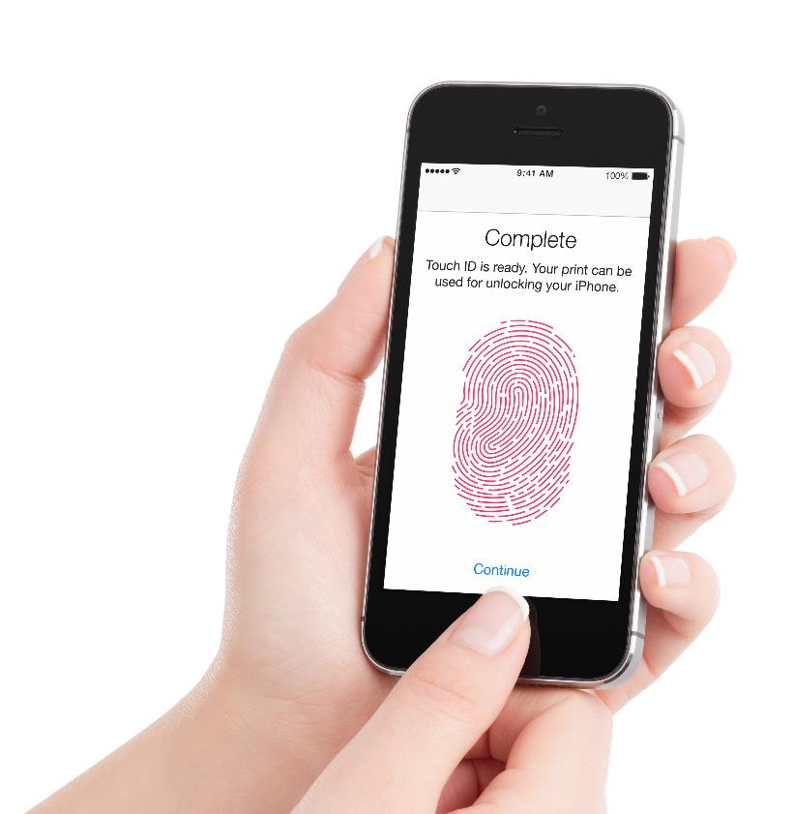
Managing security
The operating system is responsible for the security of the computer system
Authorised users are checked with a username and password combination, PIN, fingerprint or facial recognition
Access to certain programs may be restricted
Individual files may be protected
Other rights may be restricted, such as the ability to install software

Slide 23
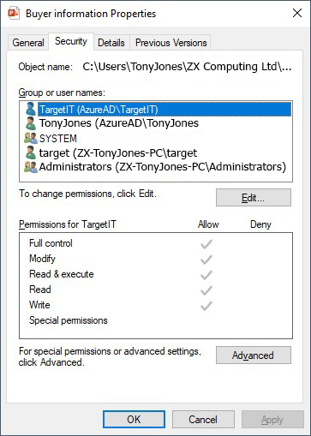
Access rights
Access rights:
If a computer is used by more than one person, users need to be restricted as to which files they may see
A user may be given access to just the files they have made, whilst a system administrator may have access to all files
Some users may be allowed to read files but not edit them
Discuss how access rights are used in your school

Slide 24
Worksheet 2
Complete Task 3 on Worksheet 2b Jigsaw

Slide 25
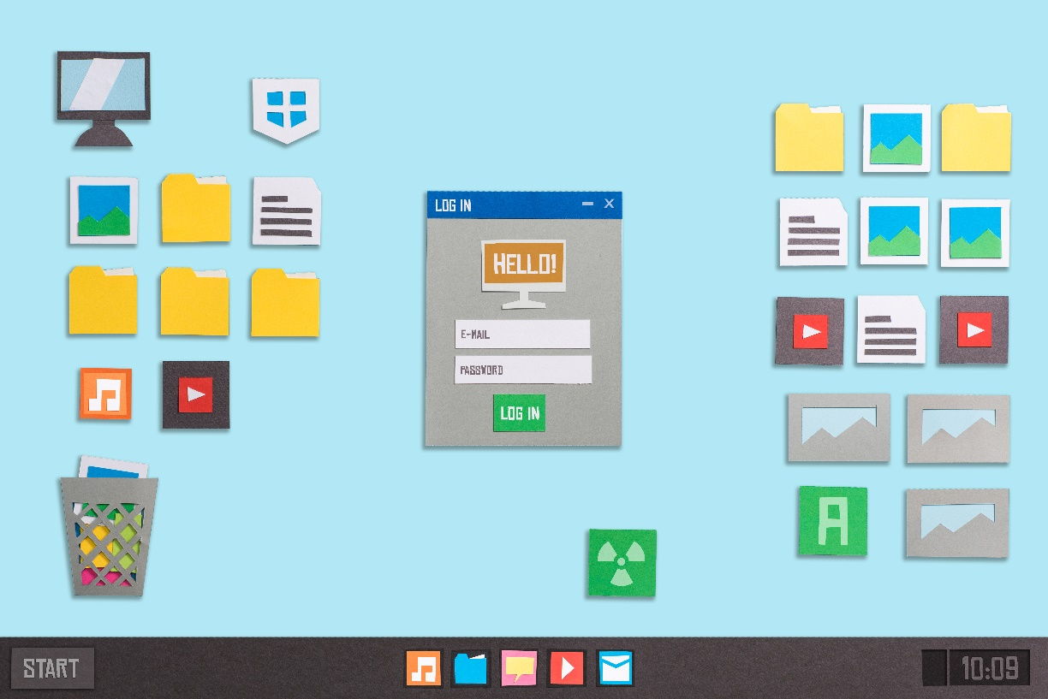
Plenary
In pairs, name eight functions that operating systems are responsible for

Slide 26
Plenary
Name eight functions that operating systems are responsible for:
Managing files
Providing an interface
Managing peripherals and drivers
Managing memory
Managing multitasking
Providing a platform for running applications
Providing system security
Managing user accounts

